Slide 1
La Clase de AP
Lengua y Cultura Española

Slide 2
Three Modes of Communication
Communication
Interpersonal Speaking and Listening
(Spontaneous, daily conversations)
Presentational Speaking and Writing
(Memorized dialogues, prepared writing prompts)
Interpretative Reading and Listening
(Reading and Listening to Authentic materials)

Slide 3
6 Tasks of AP Class and Exam
Presentational Speaking – Cultural Comparison
Presentational Writing – Persuasive Essay
Interpersonal Speaking – Impromptu Conversation
Interpersonal Writing – Email Reply
Interpretive Listening – To podcasts, news reports, etc.
Interpretive Reading – Articles, Literature, Graphics, Tables

Slide 4
The AP Exam
50% multiple choice
Includes Interpretive Reading and Listening to Authentic Audio pieces.
50% Performance Based
Includes Presentational Speaking and Writing and Interpersonal Speaking and Writing

Slide 5
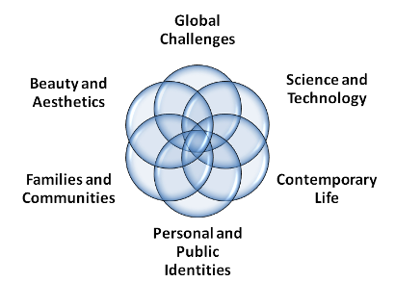
6 Themes of AP Spanish Language and Culture

Slide 6
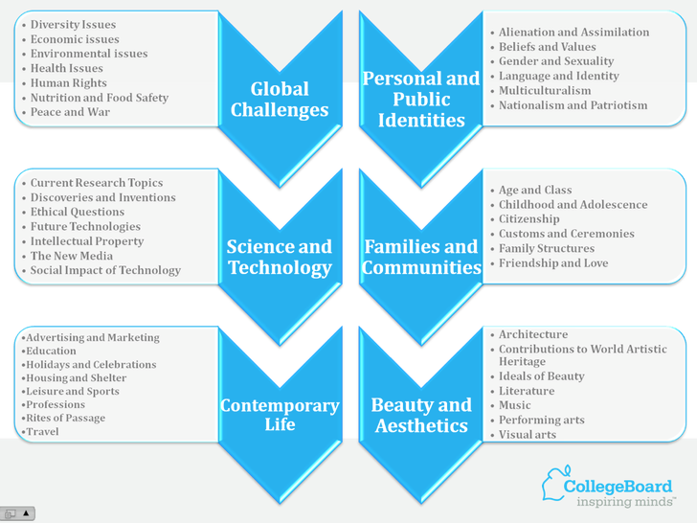
Subthemes of the 6 Main Themes

Slide 7
In class we/you will be…
Listening and reading authentic Spanish language.
Writing email replies.
Writing persuasive essays.
Investigating different Hispanic communities and comparing them to your own.
Defining what IS a community.
Speaking, a lot!!!
Exploring current issues.
Using the AP Scoring Guidelines to help you succeed in the course and on the exam.

Slide 8
La Pregunta Esencial
¿Qué es una comunidad?

